Slide 1

MLOps minutes
Questions to ask before building an AI
Guillaume Chervet

Slide 2
Baseline
MLOps Minutes – Guillaume Chervet

Slide 3
Baseline
Dataset of 10 000 pdfs
1% Cats
20% Dogs
79% Others
MLOps Minutes – Guillaume Chervet
Le MLOps est une aventure Humaine – Guillaume Chervet
Notes:
Before starting the demo. Imagine that we have 20,000 files available. We will use 17,000 files for training the model. Then we will keep 3000 files aside for validation, to test our model on data it has never seen. This validation DATASET will also be used to test our production environments.

Slide 4
Feedbacks
Recipes for success
Recipes to fail

Slide 5

Forget customer needs
Recipes to fail
At the pizzeria
"set table with glass plates and cutlery on a table"
MLOps Minutes – Guillaume Chervet
Notes:
Now we're going to set up the table for our customers. So, if you want to ruin a project it can be a very good idea not to focus on the user needs.
First example, on the driving license project, we were asked to read the documents in less than 10 seconds. When we started working on it, we deploy on production environment the very first algorithm that Data Scientists gave to us, the Splitter of PDF. We quickly realized that the times of one extraction took around 15 to 30 seconds, which was very problematic. The Data Scientists did not notice it because they work on overpowered machines which perform the operation very quickly.
Second example, when we were a little further on the project. We realized that some readings were very slow and clogged the systems. By looking a little more in detail at that the documents. We found that, in general, there were almost unreadable document event for a human. For this kind of case, it would have been a good idea to go see the users and to ask them if it would not be a better idea to report immediately that the document is not clean enough. It would have been better for the system and final users which wait 40 seconds before getting very bad results.

Slide 6

Recipes for success
Focus on Users needs
MLOps Minutes – Guillaume Chervet
Notes:
The most important thing in a project is to meet user’s needs.
User wants a good prediction quality,
User wants the cheapest project as possible,
User doesn’t want to wait for a result. At AXA France we must answer a prediction in less than 10 seconds for our use-cases.
Safety is non-negotiable.
We want the projects to be monitored. The idea is that if DATA DRIFT starts, this risk causing a production incident. If we are on a major project that can block AXA France, we are not going to wait for the incident to come.
So, the last point, we must be able to re-train and redeploy quickly. If we have a major incident that blocks AXA France, we must be able to re-deploy as quickly as possible and not wait months to unblock the situation.

Slide 7
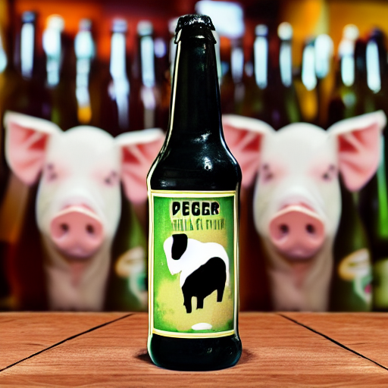

Use Deep Learning Everywhere
Recipes to fail
Deep Learning
Code classique
LLM
LLM
"bottle of beer with a pig on the label"
"bottle of champagne gold"
MLOps Minutes – Guillaume Chervet
Notes:
Now we're going to set up the table for our customers. So, if you want to ruin a project it can be a very good idea not to focus on the user needs.
First example, on the driving license project, we were asked to read the documents in less than 10 seconds. When we started working on it, we deploy on production environment the very first algorithm that Data Scientists gave to us, the Splitter of PDF. We quickly realized that the times of one extraction took around 15 to 30 seconds, which was very problematic. The Data Scientists did not notice it because they work on overpowered machines which perform the operation very quickly.
Second example, when we were a little further on the project. We realized that some readings were very slow and clogged the systems. By looking a little more in detail at that the documents. We found that, in general, there were almost unreadable document event for a human. For this kind of case, it would have been a good idea to go see the users and to ask them if it would not be a better idea to report immediately that the document is not clean enough. It would have been better for the system and final users which wait 40 seconds before getting very bad results.

Slide 8
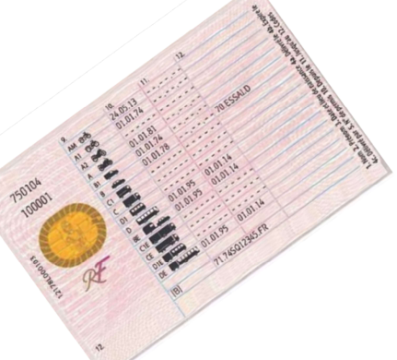

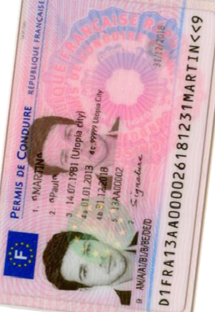
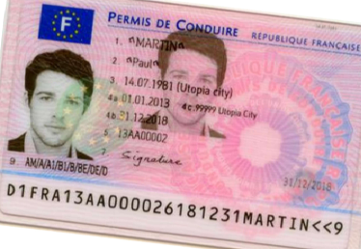
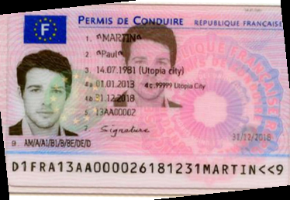
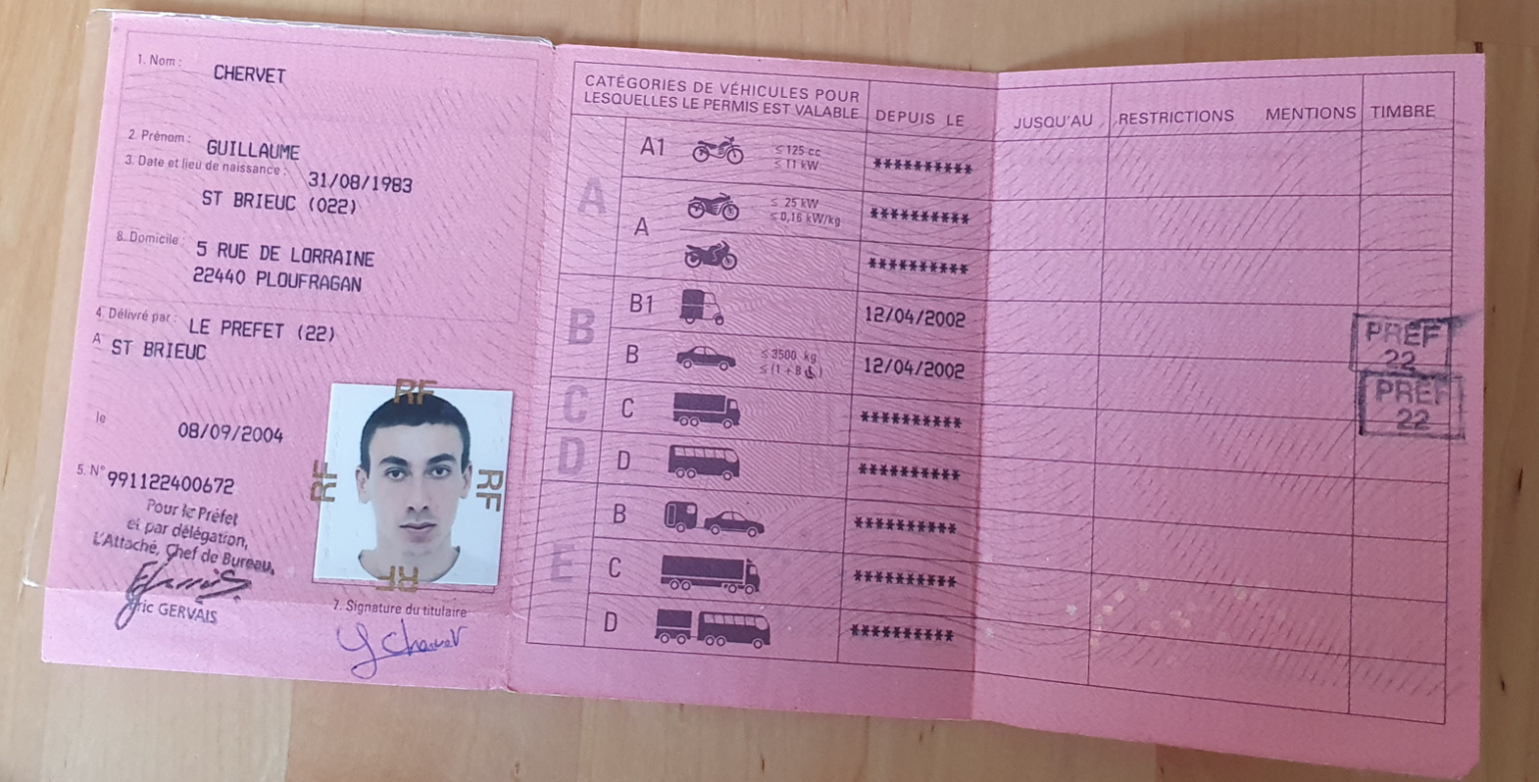
Use Deep Learning Everywhere
Recipes to fail
4 Go
5,5 Go
512 Mo
Orientation
Rotation
Homography
1 s
3 s
0,5 s
4 Go
5,5 Go
512 Mo
Orientation
Rotation
Homography
1 s
3 s
0,5 s
Legend :
5,5 Go
512 Mo
ML + code
Orientation
Homography
1 s
0,5 s
Only code
MLOps Minutes – Guillaume Chervet
Notes:
Now we're going to set up the table for our customers. So, if you want to ruin a project it can be a very good idea not to focus on the user needs.
First example, on the driving license project, we were asked to read the documents in less than 10 seconds. When we started working on it, we deploy on production environment the very first algorithm that Data Scientists gave to us, the Splitter of PDF. We quickly realized that the times of one extraction took around 15 to 30 seconds, which was very problematic. The Data Scientists did not notice it because they work on overpowered machines which perform the operation very quickly.
Second example, when we were a little further on the project. We realized that some readings were very slow and clogged the systems. By looking a little more in detail at that the documents. We found that, in general, there were almost unreadable document event for a human. For this kind of case, it would have been a good idea to go see the users and to ask them if it would not be a better idea to report immediately that the document is not clean enough. It would have been better for the system and final users which wait 40 seconds before getting very bad results.

Slide 9

Recipes for success
Use the right tool for the right Job
MLOps Minutes – Guillaume Chervet
Notes:
The most important thing in a project is to meet user’s needs.
User wants a good prediction quality,
User wants the cheapest project as possible,
User doesn’t want to wait for a result. At AXA France we must answer a prediction in less than 10 seconds for our use-cases.
Safety is non-negotiable.
We want the projects to be monitored. The idea is that if DATA DRIFT starts, this risk causing a production incident. If we are on a major project that can block AXA France, we are not going to wait for the incident to come.
So, the last point, we must be able to re-train and redeploy quickly. If we have a major incident that blocks AXA France, we must be able to re-deploy as quickly as possible and not wait months to unblock the situation.

Slide 10
Extraction
Dataset pdfs
DataSplit
Train
Dataset labels
Le MLOps est une aventure Humaine – Guillaume Chervet

Slide 11
Conclusion
Le MLOps est une aventure Humaine – Guillaume Chervet

